Slide 1

Company Bankruptcy Prediction
Hoyeon Kang 1229481593
Florence Lee 1228485299
Homer Liu 1230540209
Shobhit Diggikar 1231017010
Anne Silvia Dasi 1231114146

Slide 2





Our Team...
Hoyeon Kang
Florence Lee
Homer Liu
Shobhit Diggikar
Anne Silvia Dasi

Slide 3




Business Goal
Target
Objective
Value
Investors
Review company financial status before investment
Predictive model
Assess risk of
company bankruptcies
Avoid high-risk companies
Allocate the resources effectively to secure investments

Slide 4
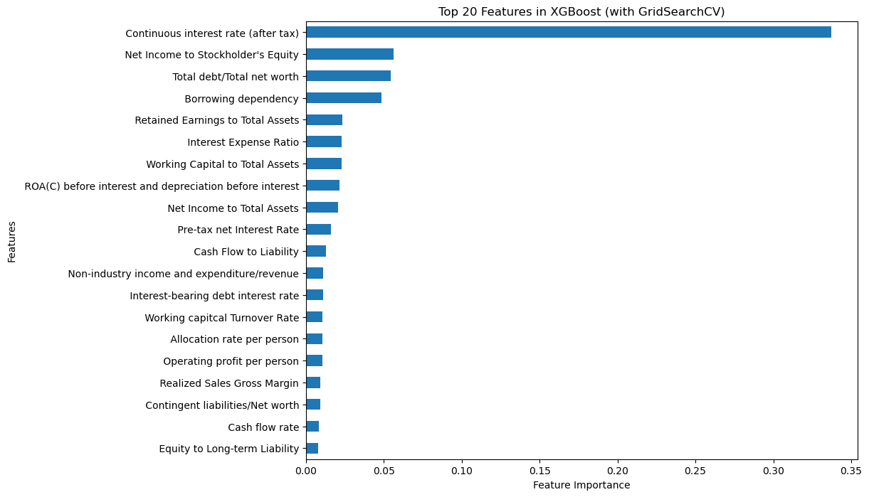
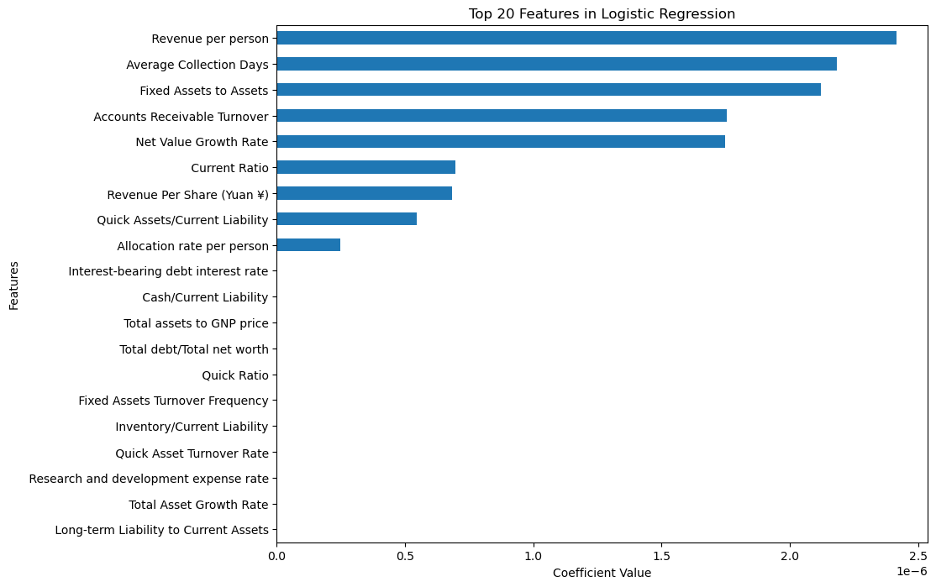
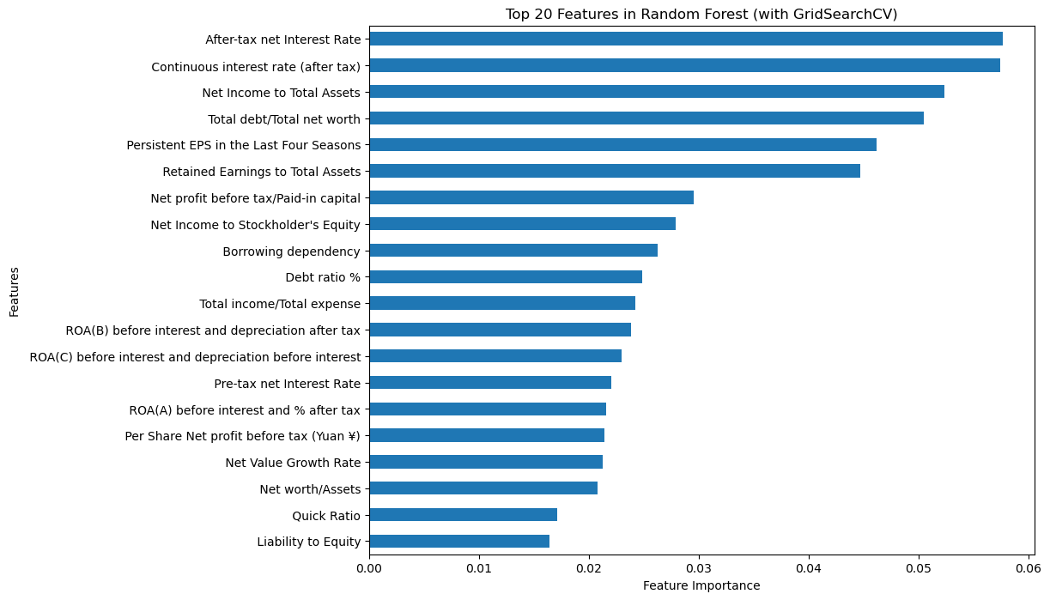
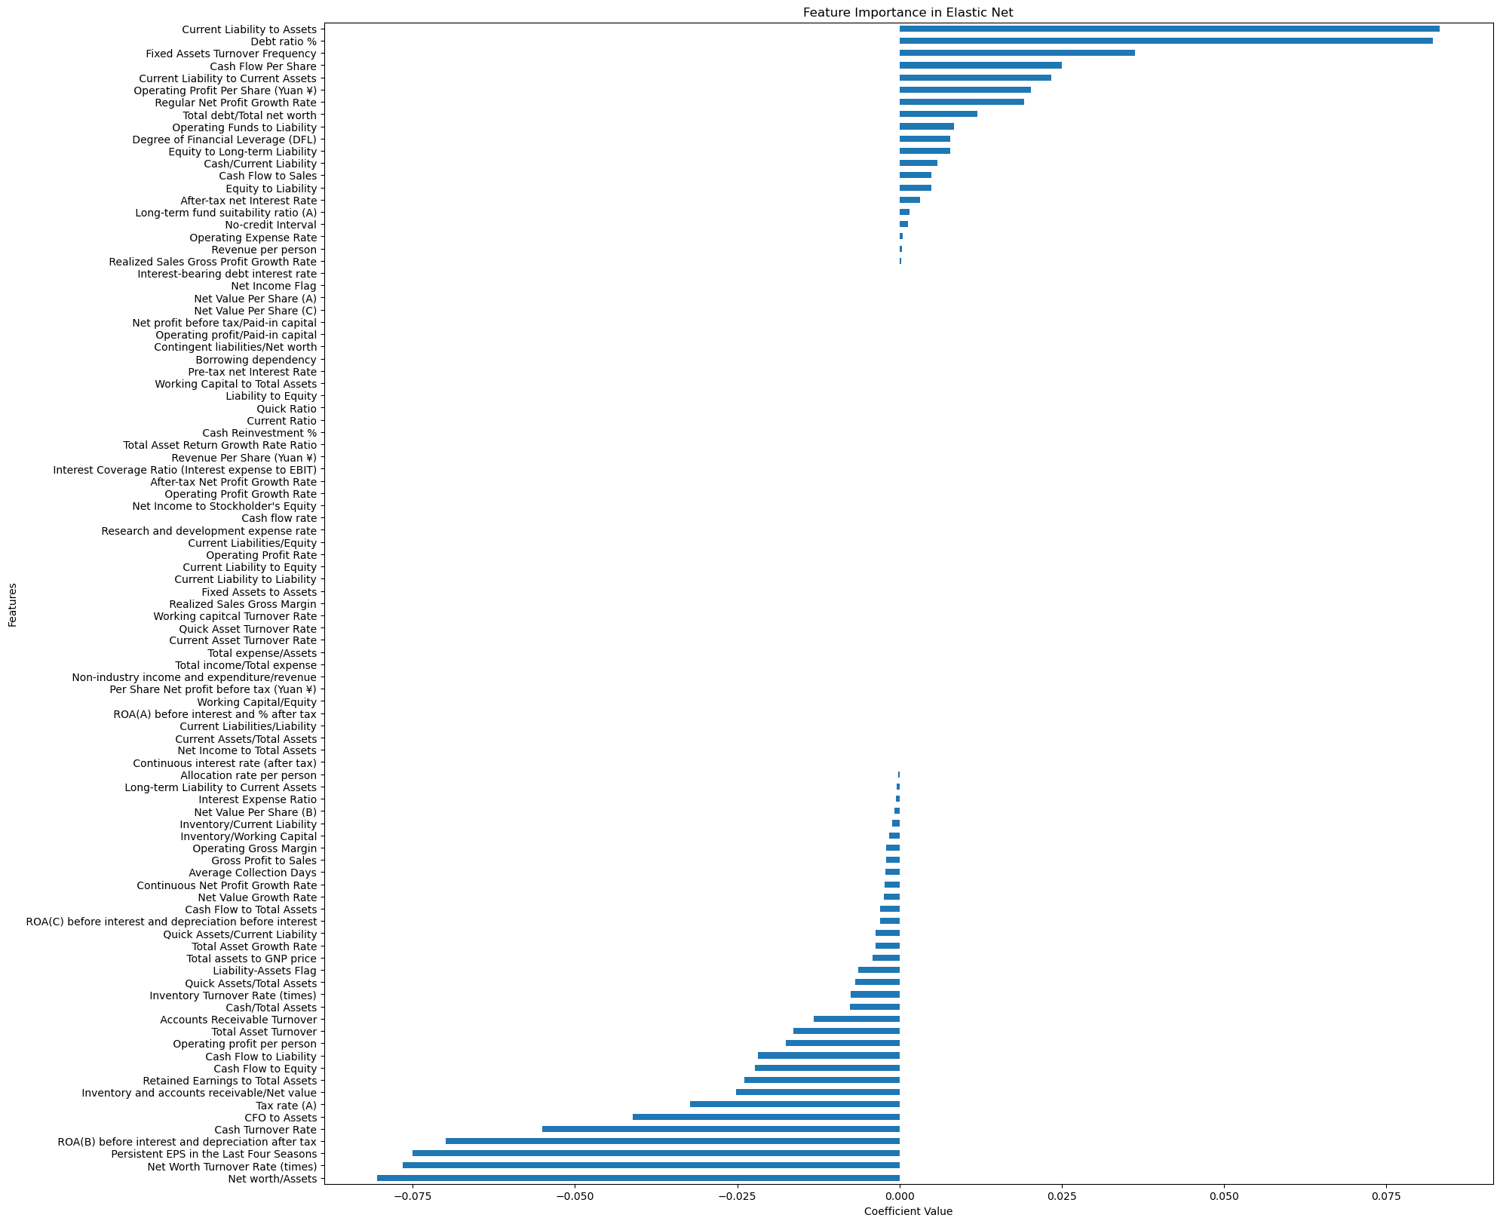
Explore the Data- Feature Importance
Target Feature | Total 95 features
Bankruptcy? | Solvency | Liquidity | Profitability
XGBoost
Ridge
Logistic Regression
Random Forest

Slide 5
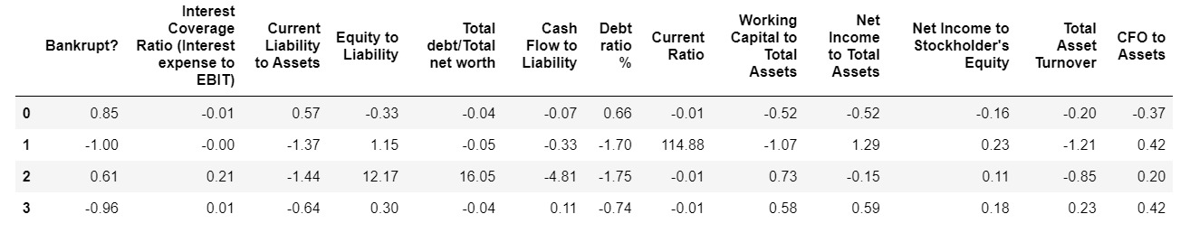
Key Feature Importance
Target Feature | Key 12 Features

Slide 6
.
Modeling

Slide 7
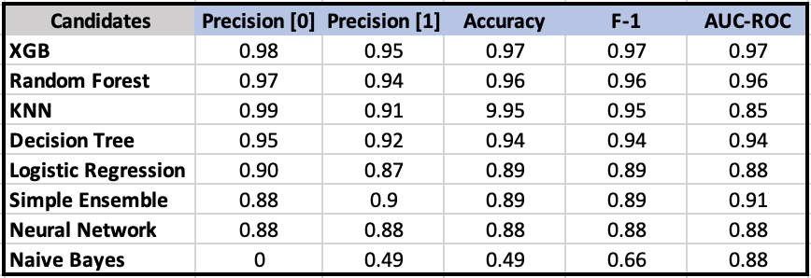
Model Performance Comparison

Slide 8
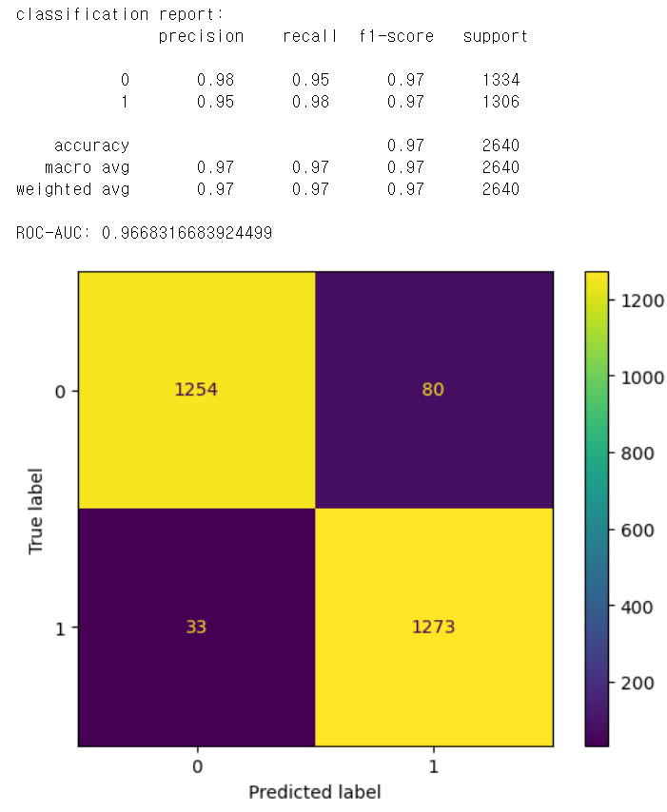
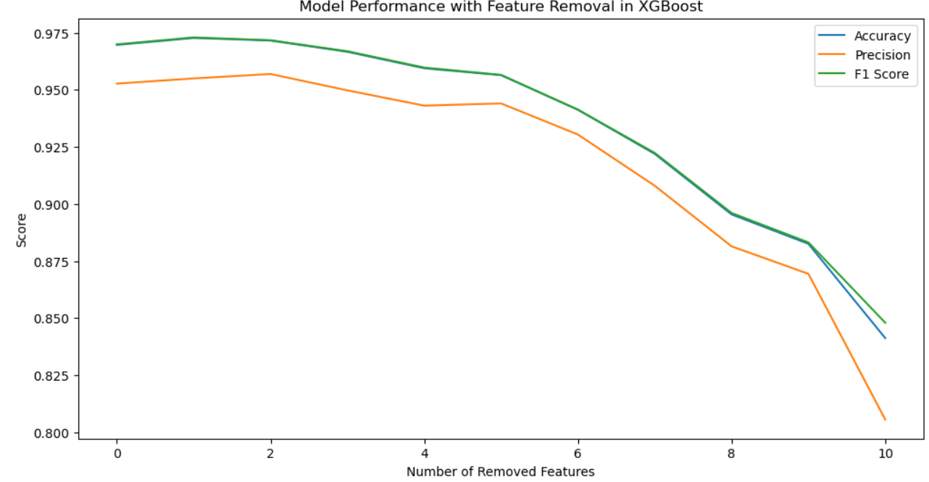
XGBoost

Slide 9

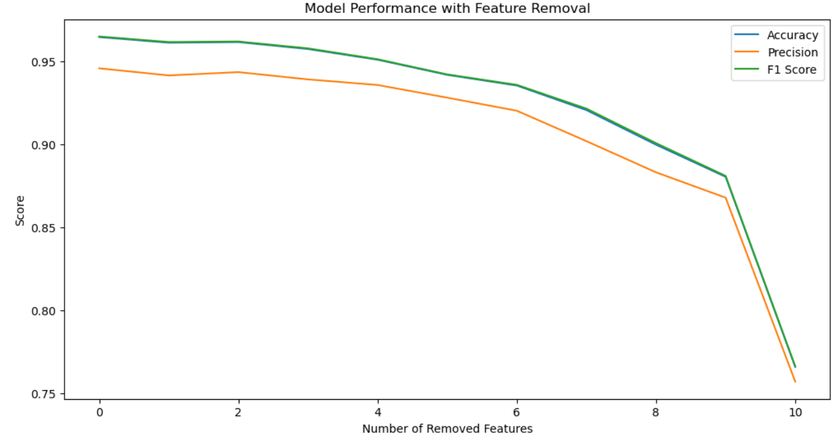
Random Forest

Slide 10
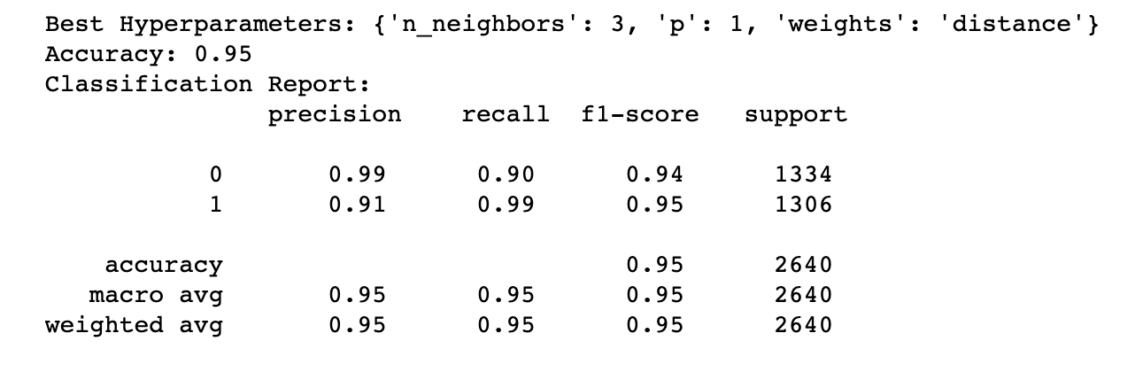
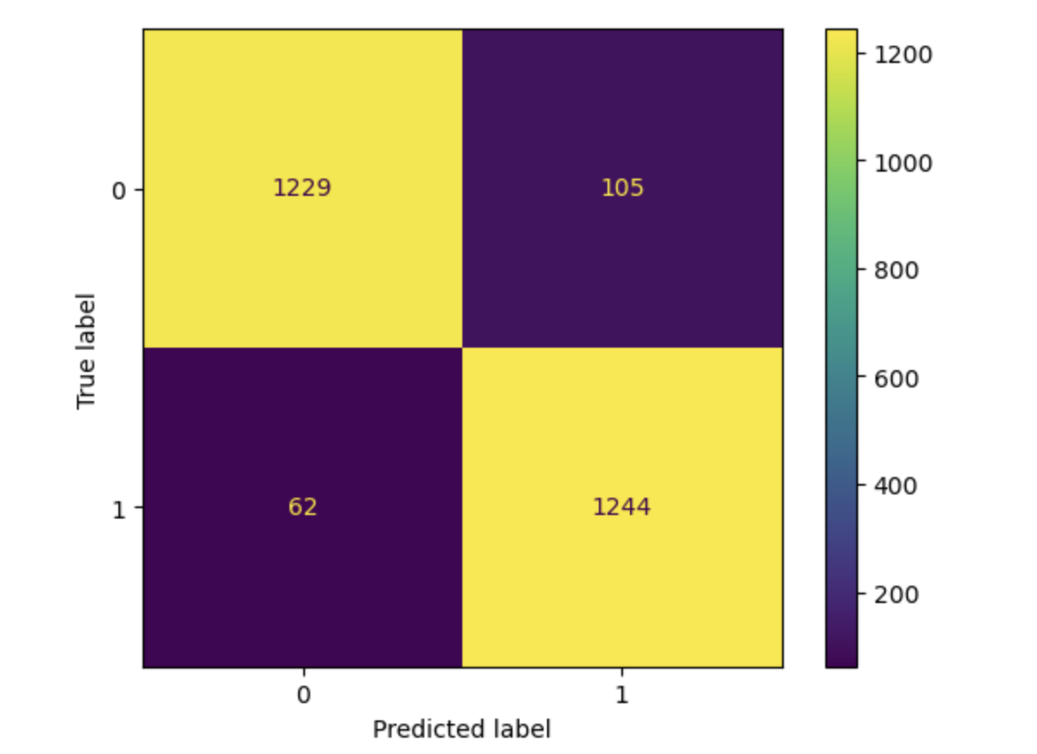
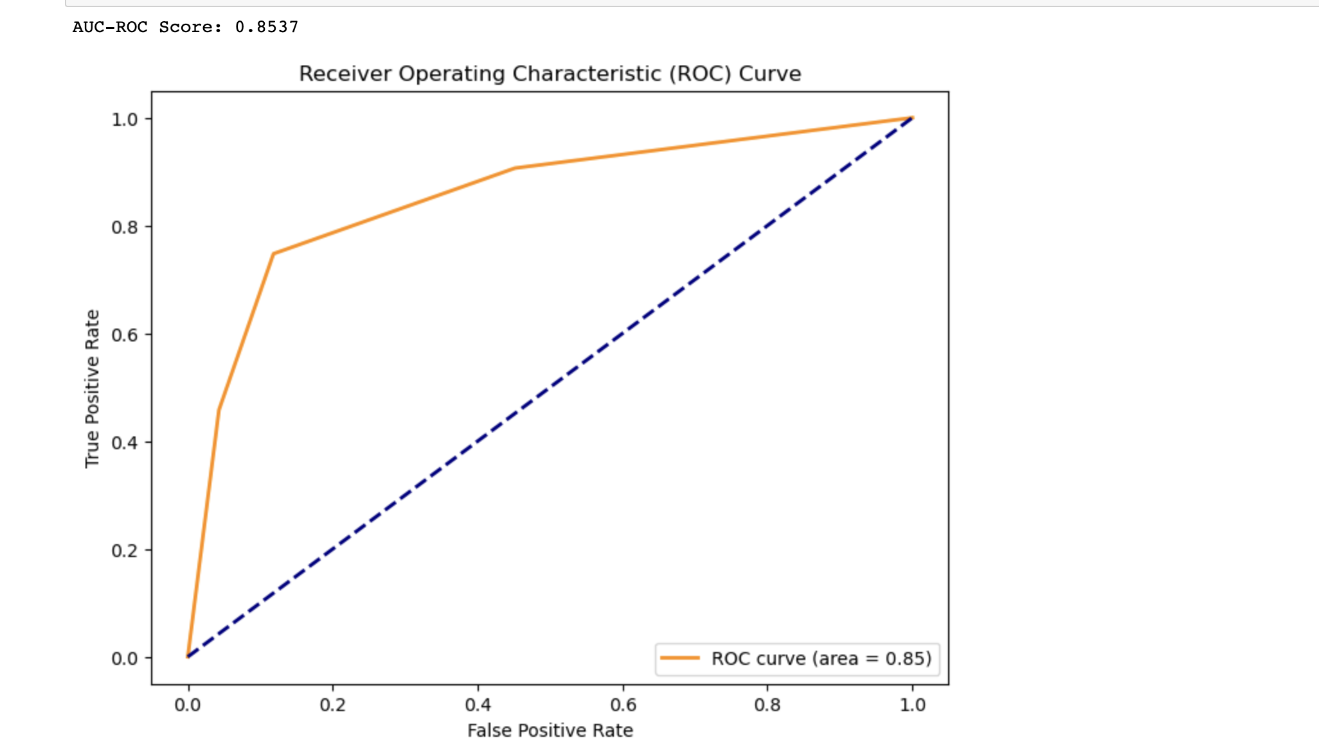
KNN

Slide 11
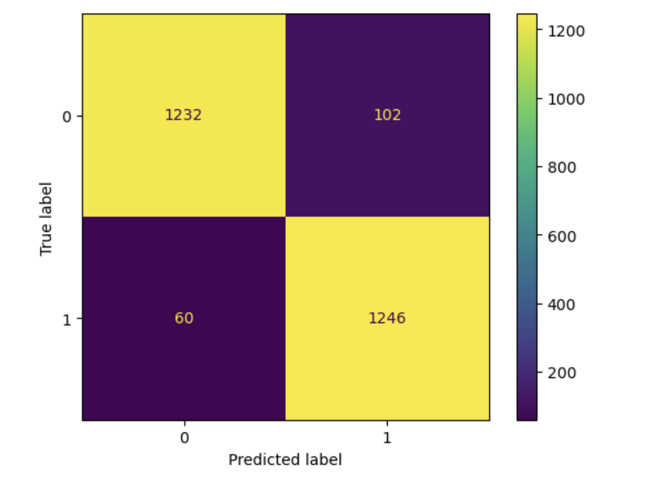
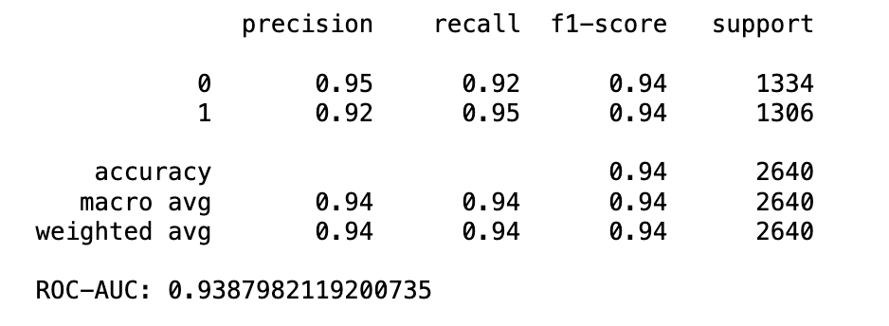
Decision Tree

Slide 12

Model pros and cons/logics
Algorithm | Pros | Cons
XG Boost | Iteratively corrects the mistakes of previous trees and includes regularization to avoid overfitting | Powerful but complex, interpretability can be a hurdle.
Random Forest | High accuracy and reduced overfitting. Robust and powerful. | Risk of overfitting. Ensemble approach masks individual tree insights.
KNN | Simple, fast, and highly accurate for smaller datasets. Effective for multi-class problems. | Sensitive to dimensionality and noise in data.
Decision Tree | Transparency and interpretability. Logical step-by-step solutions. | Prone to overfitting and sensitivity to specific features.

Slide 13
.
Evaluation

Slide 14
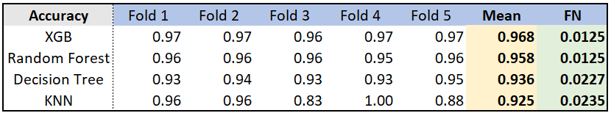


5-folds cross-validation
Accuracy: (TP+TN) / (TP+TN+FP+FN) → Predictive Performance
False Negative(FN): a case where the model incorrectly predicts a company as financially stable when, in fact, it is on the verge of bankruptcy → Risk / Loss

Slide 15
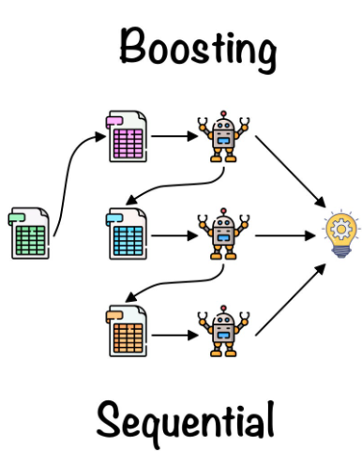



Why XGBoost over Random Forest?
Boosting
Faster!
In-built Overfitting Penalty
Missing Value Handling
Error correcting approach
Level-wise tree growth
GPU computation
L-1 & L-2 regularization
Tree pruning
Simplified maintenance
Operational efficiency

Slide 16
.
Benefits and Business Value of Successful Models

Slide 17






Minimize Risks
Healthy Investment
Efficiency Gains
Decreasing the number of bad loans leads to reduced asset losses, lower legal costs, and cost related to debt recovery.
Allowing for the reallocation of capital to more profitable ventures, thereby improving capital utilization.
Saving time in manual analysis and improving the speed of decision-making, which is impact on operational efficiency.
Losses Reduction
Revenue Increases
Satisfied Customers

Slide 18
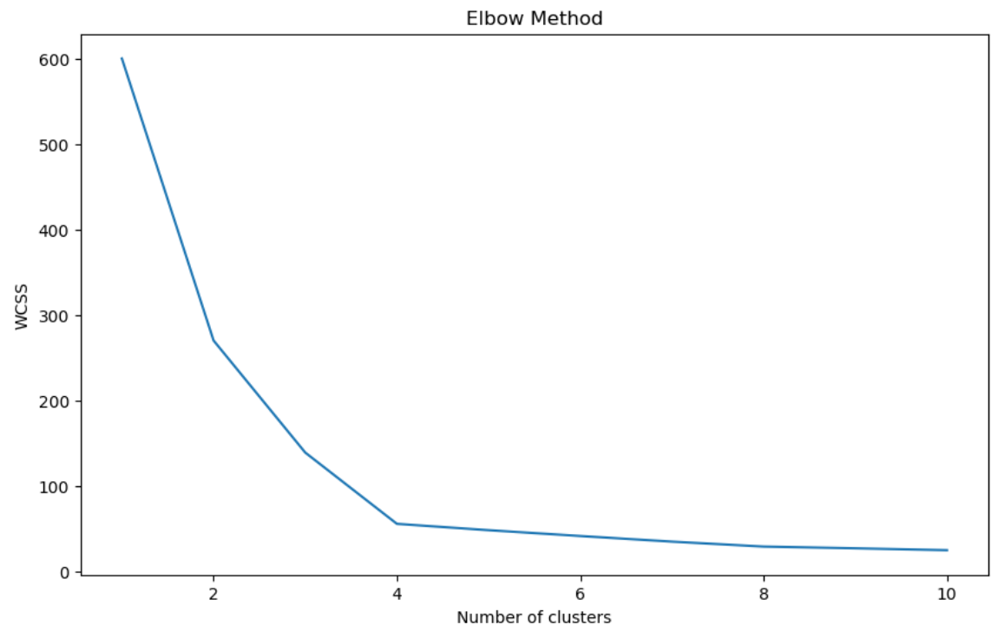
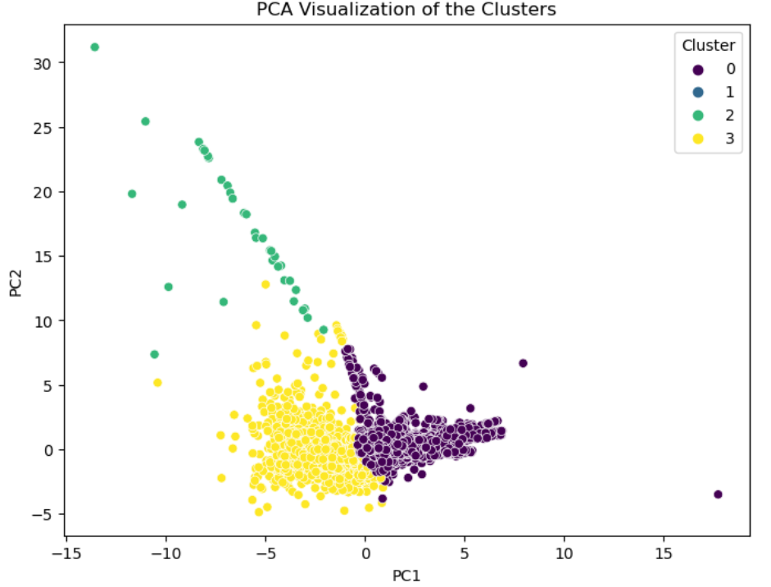
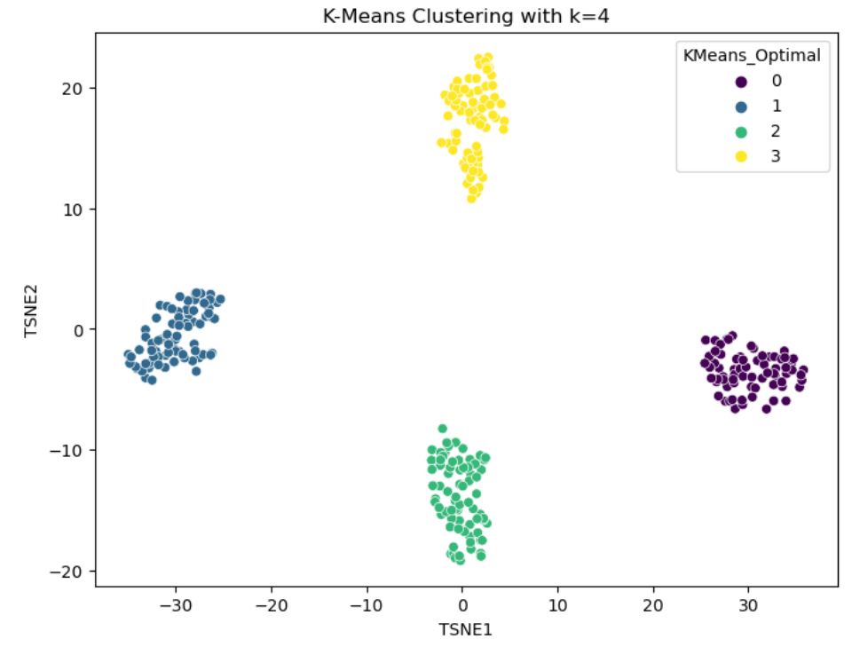
Feature values of centroids
# clusters = 4
After understanding details of each group, we can build different business strategies to corresponding customers.

Slide 19
.
Deployment

Slide 20
New Model Deployment
1
2
3
Model Ready
Production
Environment
Deployment
New Company
Finance Review
Process
Fully Tested in Staging Environment
Mitigates risks prior to production release
Establish Platform and Infrastructure Readiness
Confirm required infrastructure for deployment
Comprehensive User Training
Schedule training sessions for staff interaction with the model
End User Training & Acceptance
Train employees for effective use and address adoption resistance
Seamless Integration with Existing Systems
Allocate IT resources and plan to avoid disruptions during integration
Ensure Regulatory compliance Adhere to applicable legal frameworks

Slide 21




Risk & Mitigation Plan
Regulatory Changes
Risk: Risk of non-compliance due to evolving financial regulations
Mitigation: Regularly update protocols to align with the latest regulatory standards
Model Accuracy and Data Integrity
Risk: Risk of inaccurate financial predictions due to model errors and data inadequacies.
Mitigation: Enhance model precision with a continuous learning feedback loop and ensure robust, high-quality data. Regularly update and cleanse data inputs to maintain accuracy.
Data Security & Privacy
Risk: Potential for data breaches and privacy violations
Mitigation: Adopt stringent security protocols, advanced encryption, and compliance with data protection regulations
Over-reliance on the Model
Risk: Risk of disregarding professional judgment in favor of model output
Mitigation: Promote the model as an augmentative tool to support, not replace, expert decision-making

Slide 22
.
Thanks!

